Slide 1
Java Introduction and Fundamentals
Md. Mizanur Rahman
Lecturer, DIU

Slide 2
Introduction
Java is a high level, class based, object oriented programming language that is widely used across various operating systems.
To build Java programs, you need to have the Java Development Kit (JDK) installed on your device. However, if you're eager to start immediately, you can use a free online Java compiler that allows you to run Java code directly in your browser without any setup.

Slide 3
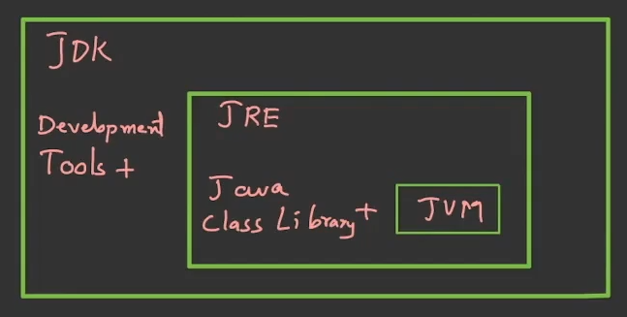
JDK

Slide 4
Run A Java Program
Open Notepad and enter the following code:
Then save this file as HelloWorld.java (select "All Files" in "Save as type").
Open your command prompt in that folder and run the following commands.
class HelloWorld {
public static void main(String[] args) {
System.out.println("Hello, World!");
}
}
javac HellowWorld.java
java HelloWorld

Slide 5
Basic Structure of Java Program
A Java program requires a lot of lines even for a simple program but for now, just remember this following structure.
class Main {
public static void main(String[] args) {
...
}
}

Slide 6
Comments in Java Program
Java comments are similar to C/C++ comments.
Single Line Comments:
Multi-line Comments:
class HelloWorld {
public static void main(String[] args) {
// print Hello World to the screen
System.out.println("Hello World");
}
}
class HelloWorld {
public static void main(String[] args) {
/* System.out.println("Hello, World!");
System.out.println("Hello, World!");
System.out.println("Hello, World!"); */
}
}

Slide 7
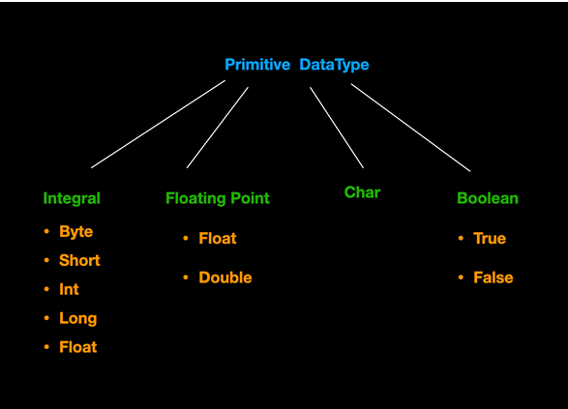
Java Data Types (Primitive)

Slide 8
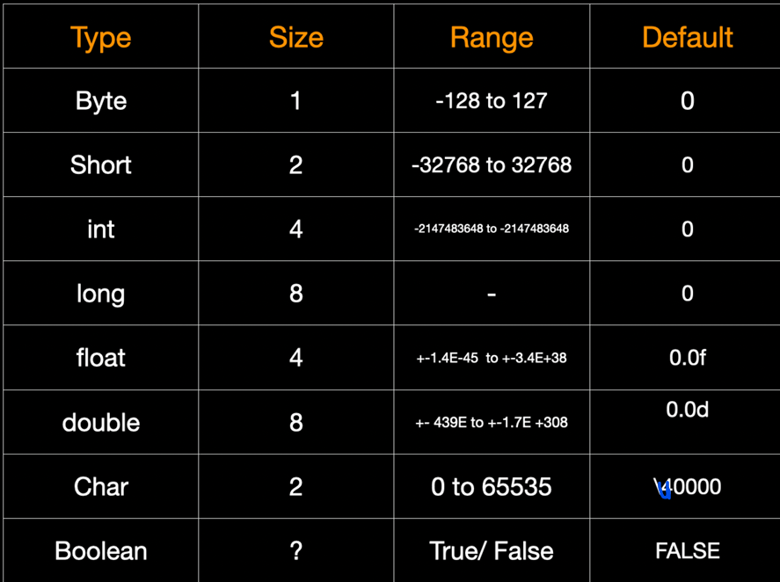
Java Data Types (Primitive)

Slide 9
Java Data Types (Primitive)
Basic Structure of Declaration and Definition is similar to C/C++.
Categories:
boolean
byte
short
int
long
double
float
char
dataType variable_Name = Value;
boolean flag = true;
byte range;
range = 124;
short temperature;
temperature = -200;
int range = -4250000;
long range = -42332200000L;
double number = -42.3;
float number = -42.3f;
char letter1 = '9';

Slide 10
Reading from Keyboard
Import java.lang.*;
Import java.util.*;
public class MyFirst {
public static void main(String[] args) {
// TODO code application logic here
System.out.println("Hello World");
System.out.println("Int min: " + Integer.MIN_VALUE);
System.out.println("Int max: " + Integer.MAX_VALUE);
Scanner s = new Scanner(System.in);
int a, b, c;
System.out.println("Enter two number");
a = s.nextInt();
b = s.nextInt();
c = a + b;
System.out.println("c = a + b : " + c);
}
}
class Scanner
nextInt()
nextFloat()
nextDouble()
next()
nextLine()
nextByte()
nextShort()
nextLong()
nextBoolean()
hasNextInt()
hasNextFloat()

Slide 11
Java Operators
Operators in Java can be classified into 5 types:
Arithmetic Operators
Assignment Operators
Relational Operators
Logical Operators
Unary Operators
Bitwise Operators

Slide 12
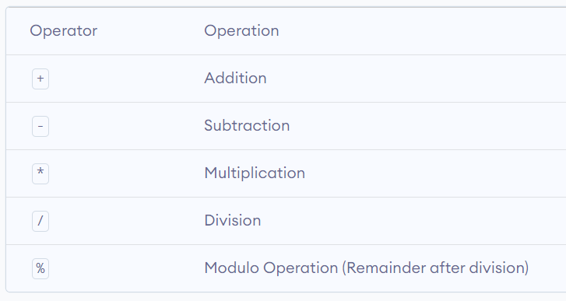
Arithmetic Operators
Operator | Operation
+ | Addition
- | Subtraction
* | Multiplication
/ | Division
% | Modulo Operation (Remainder after division)

Slide 13
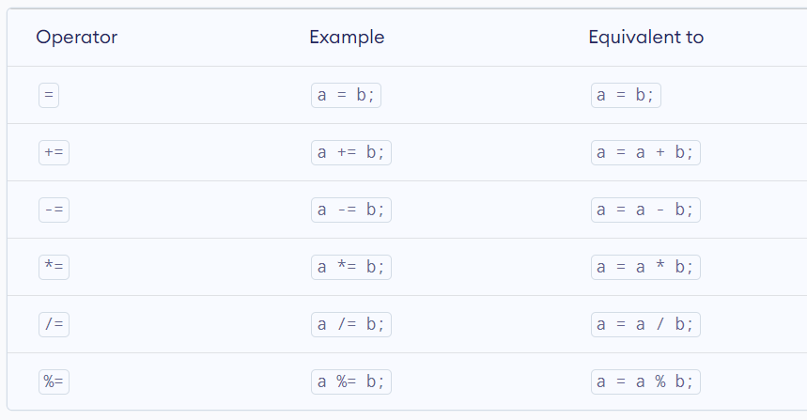
Assignment Operators
Operator | Operation
+ | Addition
- | Subtraction
* | Multiplication
/ | Division
% | Modulo Operation (Remainder after division)

Slide 14
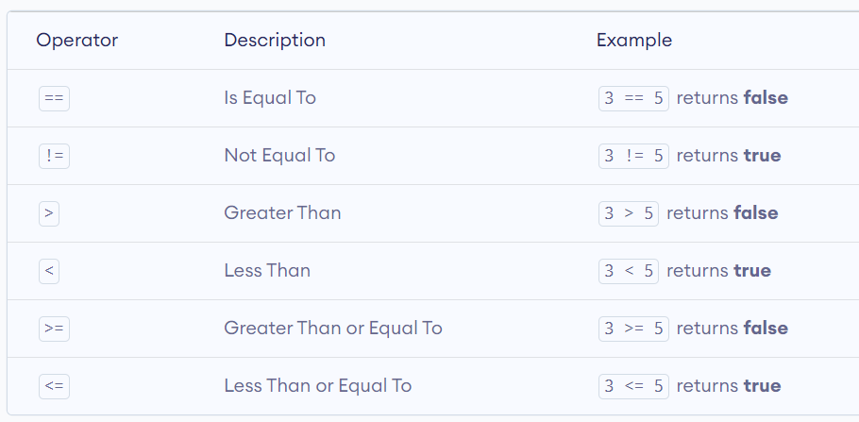
Relational Operators
Operator | Operation
+ | Addition
- | Subtraction
* | Multiplication
/ | Division
% | Modulo Operation (Remainder after division)

Slide 15
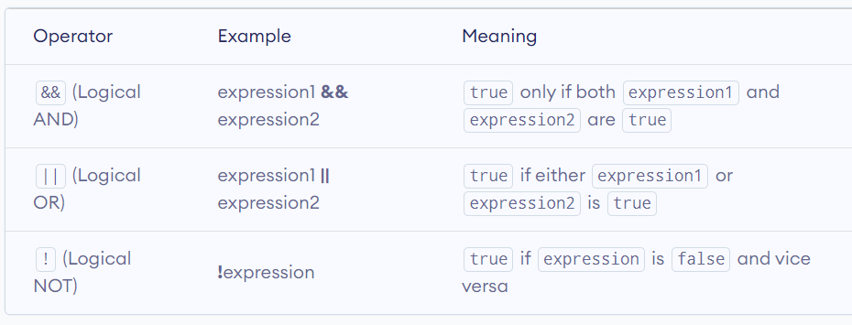
Logical Operators
Operator | Operation
+ | Addition
- | Subtraction
* | Multiplication
/ | Division
% | Modulo Operation (Remainder after division)

Slide 16
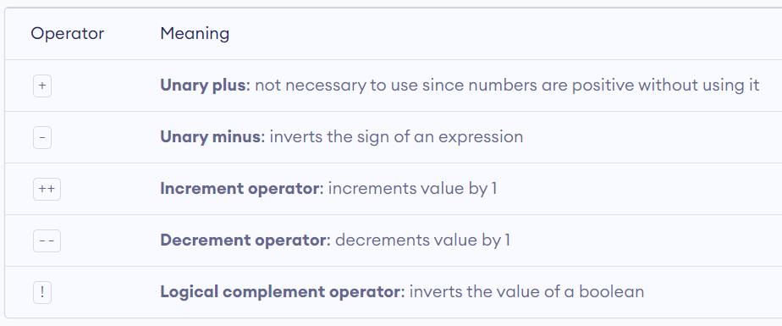
Unary Operators
Operator | Operation
+ | Addition
- | Subtraction
* | Multiplication
/ | Division
% | Modulo Operation (Remainder after division)

Slide 17
Unary Operators
Operator | Operation
+ | Addition
- | Subtraction
* | Multiplication
/ | Division
% | Modulo Operation (Remainder after division)

Slide 18
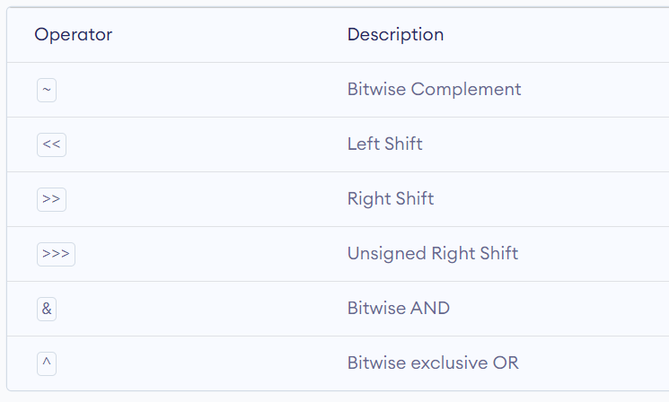
Bitwise Operators
Operator | Operation
+ | Addition
- | Subtraction
* | Multiplication
/ | Division
% | Modulo Operation (Remainder after division)

Slide 19
Other Operators
Java also provides increment and decrement operators: ++ and -- respectively. ++ increases the value of the operand by 1, while -- decrease it by 1.
Java also provides ternary operator similar to that of C++.
The instanceof operator checks whether an object is an instanceof a particular class.
class Main {
public static void main(String[] args) {
String str = "Programiz";
boolean result;
result = str instanceof String;
System.out.println("Is str an object of String? " + result);
}
}

Slide 20
Basic Output in Java
System.out.println(); or
System.out.print(); or
System.out.printf();
You can use any of the following.
Difference between println(), print() and printf():
print() - It prints string inside the quotes.
println() - It prints string inside the quotes similar like print() method. Then the cursor moves to the beginning of the next line.
printf() - It provides string formatting (similar to C/C++).
Try this one and see the difference.
class Output {
public static void main(String[] args) {
int d = 10;
System.out.println("1. println ");
System.out.println("2. println ");
System.out.print("1. print");
System.out.printf("2. printf %d", d);
} }

Slide 21
Try Yourself
class Variables {
public static void main(String[] args) {
Double number = -10.6;
System.out.println(5);
System.out.println(number);
}
}
class PrintVariables {
public static void main(String[] args) {
Double number = -10.6;
System.out.println("I am " + "awesome.");
System.out.println("Number = " + number);
}
}

Slide 22
Basic Input in Java
We will learn to get input from user using the object of Scanner class.
In order to use the object of Scanner, we need to import java.util.Scanner package.
import java.util.Scanner;
// create an object of Scanner
Scanner input = new Scanner(System.in);
// take input from the user
int number = input.nextInt();

Slide 23
Basic Input in Java
import java.util.Scanner;
class Input {
public static void main(String[] args) {
Scanner input = new Scanner(System.in);
// Getting float input
System.out.print("Enter float: ");
float myFloat = input.nextFloat();
System.out.println("Float entered = " + myFloat);
// Getting double input
System.out.print("Enter double: ");
double myDouble = input.nextDouble();
System.out.println("Double entered = " + myDouble);
// Getting String input
System.out.print("Enter text: ");
String myString = input.next();
System.out.println("Text entered = " + myString);
// Getting integer inout
System.out.print("Enter an integer: ");
int number = input.nextInt();
System.out.println("You entered " + number);
}
}

Slide 24
Expressions, Statements and Blocks
A Java expression consists of variables, operators, literals, and method calls.
In Java, each statement is a complete unit of execution.
We can convert an expression into a statement by terminating the expression with a ; which are known as expression statements.
A block is a group of statements (zero or more) that is
enclosed in curly braces { }.
// expression
number = 10
// statement
number = 10;

Slide 25
Try it yourself
Write a java program to calculate discount price and the amount of savings per purchase for the following problem.
Suppose, you went to a Business Fair. You will buy a book worth of 45 taka and a gift box which is 100 taka. The shopkeeper can give you 12% and 18% discount on each item. You will buy both items together.

Slide 26
References
Java - The Complete Reference by Herbert Schildt
https://www.geeksforgeeks.org/java/
https://www.w3schools.com/java/
https://www.javatpoint.com/java-tutorial
https://www.tutorialspoint.com/java/index.htm
https://www.programiz.com/java-programming
https://github.com/Rafiquzzaman420/Free-Programming-Books
YouTube Channel - thenewboston

